Slide 1
Annual minimum Arctic sea ice extent projection and uncertainty quantification under different greenhouse gas emission scenarios
UCL Faculty of Mathematical & Physical Sciences
Department of Mathematics
Presenter: Minghan Yang
Candidate ID: HMSB1
Supervisor: Professor Richard Chandler

Slide 2
Outline
Introduction
Data
Methodology
Results
Conclusion
Q&A

Slide 3
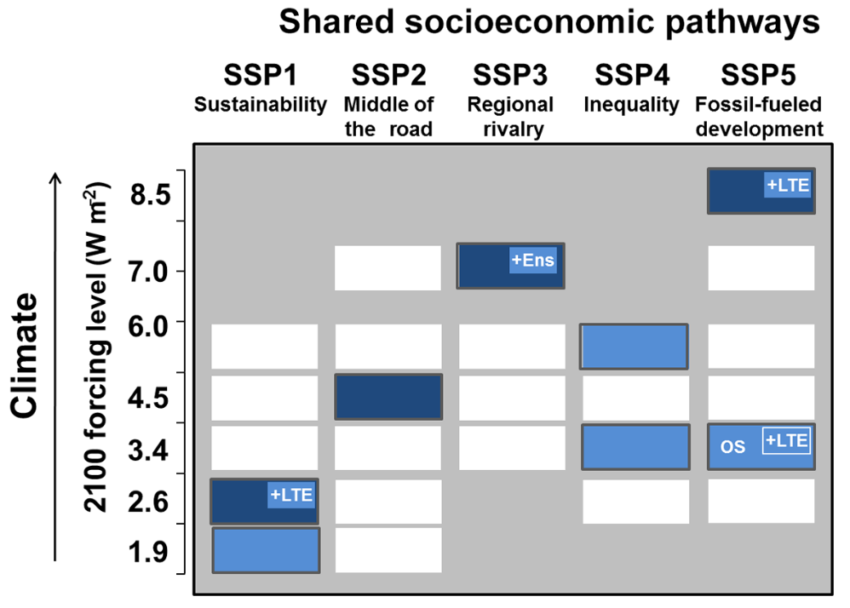
Introduction
Motivation:
The rapid Arctic warming and loss of sea ice lead to significant climatic and environmental issues.
Main causes are the natural fluctuations in the climate system and the warming that results from rising levels of greenhouse gas(GHG) emissions.
The 6th phase of Coupled Model Intercomparison Project (CMIP6) offers climate projections for the 21st century, integrating extensive climate models over the world that perform common sets of experiments under different future development pathways.
Shared Socio-economic Pathways (SSPs)
In the Sixth Assessment Report of the Intergovernmental Panel on Climate Change (IPCC):
SSP126, 245, 370, 585 are future development pathways that correspond to low, intermediate, high, and very high GHG emission scenarios.
ScenarioMIP (in CMIP6) provides simulations under these SSP settings, and its outputs help with climate projections and uncertainty quantification.
Figure 1: SSPs in ScenarioMIP. Dark blue cells are the basic scenarios SSP 126, 245, 370, 585.
Notes:
Ens: initial condition ensemble
LTE: long-term extension
OS: overshoot.

Slide 4
Related work
Inspirations from principled statistical methods in climate projections
Bayesian framework is helpful when there are multiple models.
Shared discrepancy structure for ensemble of climate model simulations helps with uncertainty quantification.
Incorporation of energy balance models (EBMs) for joining the climate trends with external forcings.
Posterior sampling is effective for uncertainty quantification.
Heuristic approaches in sea ice projections
Linear regressions.
Weighted averages of selected climate model simulations.
Unsatisfied performance in long-term projection and uncertainty quantification.
Combining the real-world quantity and many climate models can be beneficial but challenging.
Challenges & Imperfection
Aim
Based on satellite measurements of Arctic sea ice extent and multiple global climate model outputs in CMIP6, we aim to project the future Arctic sea ice in the 21st century under four different greenhouse gas emission scenarios, and quantify the associated uncertainties.
Notes:
Current appraches in sea ice projection mainly utilise linear regressions, or some model selection and weighted average methods.
Some principled statistical methods in climate

Slide 5
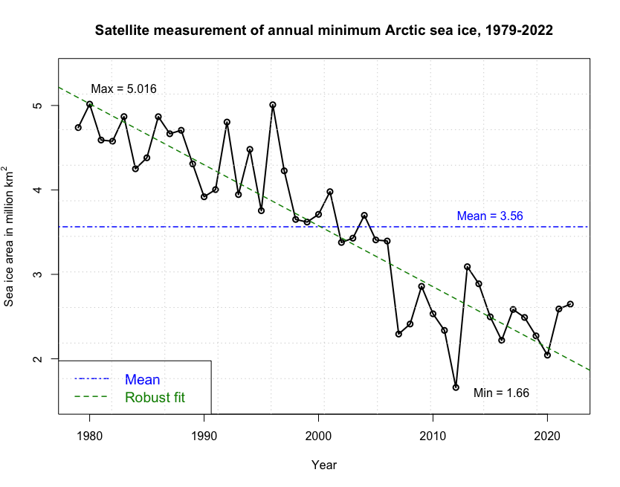
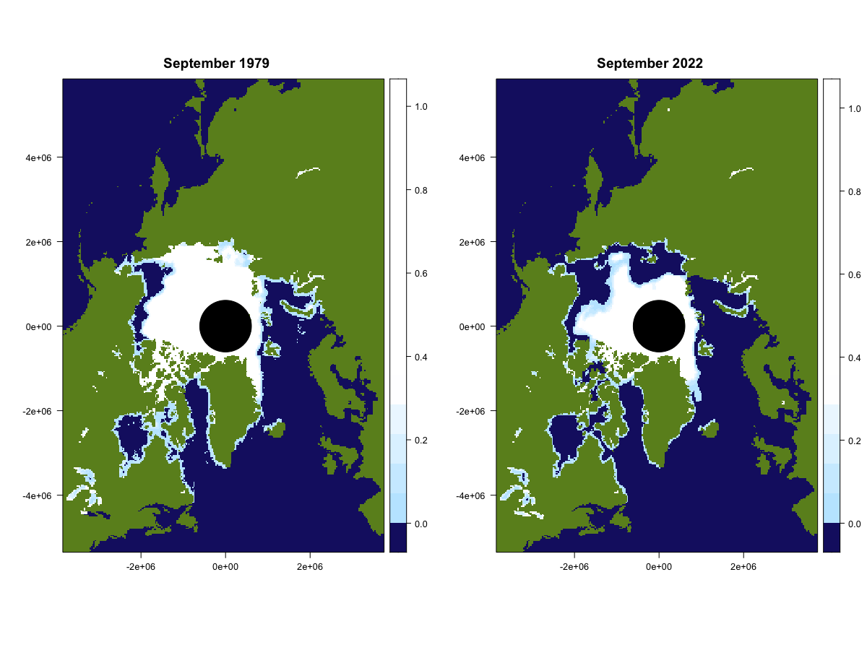
Data
Satellite measurement data, 1979-2022
The passive microwave satellite data record which provides consistent estimates of sea ice extent (in million km²).
Data source: NASA National Snow and Ice Data Center (NSIDC).
Figure 2: Distribution of Arctic sea ice fraction in September 1979 (left) and September 2022 (right) in polar stereographic projection.
Figure 3: Satellite measured annual minimum Arctic sea ice area excluding pole hole, 1979-2022.
Notes:
Mention the pole hole!

Slide 6
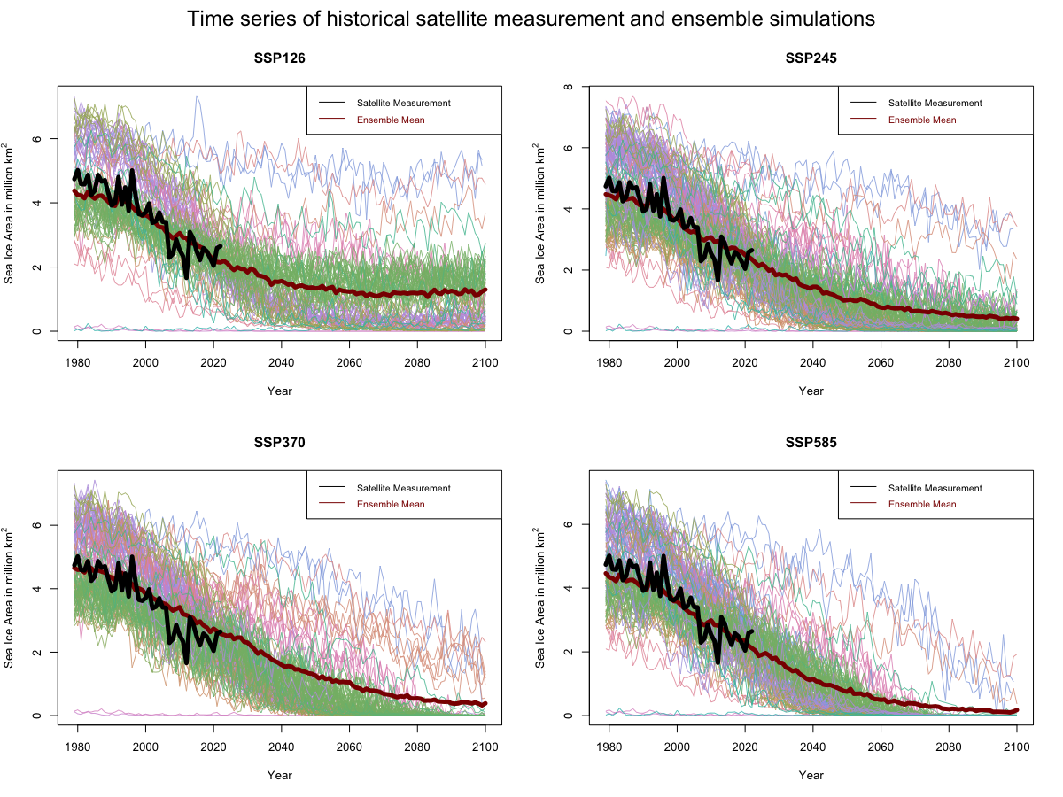
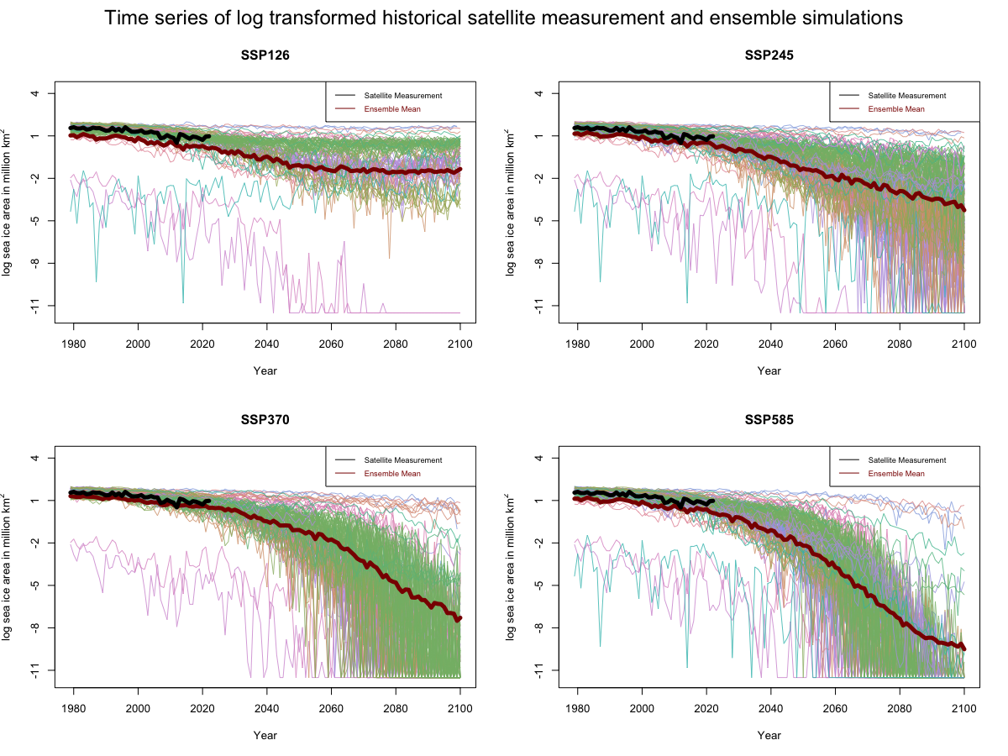
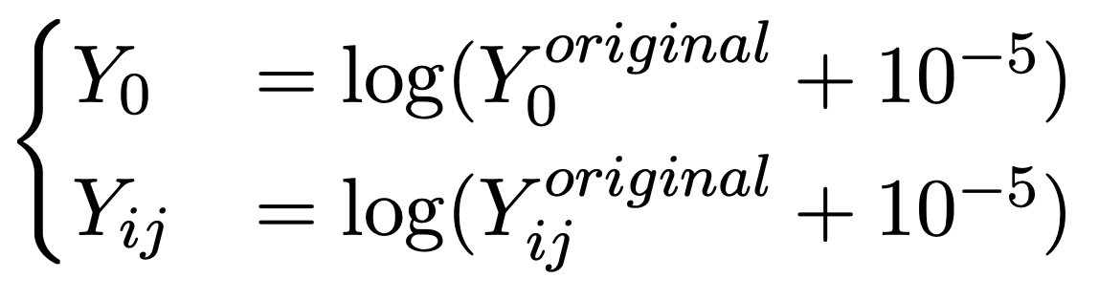
Data
Ensemble of CMIP6 simulators
Data source: CMIP6 Data Portal, under SSP 126, 245, 370 and 585 experiments.
“Simulators” – the climate models that participate in the CMIP6 who generate sea ice simulations.
“Runs” – sometimes simulators have multiple runs under different settings of initial inputs and perturbations.
“Multi-model Ensemble” – the collection of outputs from different simulators.
There are 36 simulators in total, and there are 91, 162, 143, and 133 runs in SSP126, 245, 370, and 585 experiments, respectively.
A log transformation is applied to the sea ice data for subsequent analysis.
Figure 4: Ensemble members before and after log-transformation, with historical satellite measurement and ensemble mean.
Notes:
for example, methods relying on normal distributions might not be appropriate for non-negative quantities. To address this limitation, one option is to apply data transformation.

Slide 7
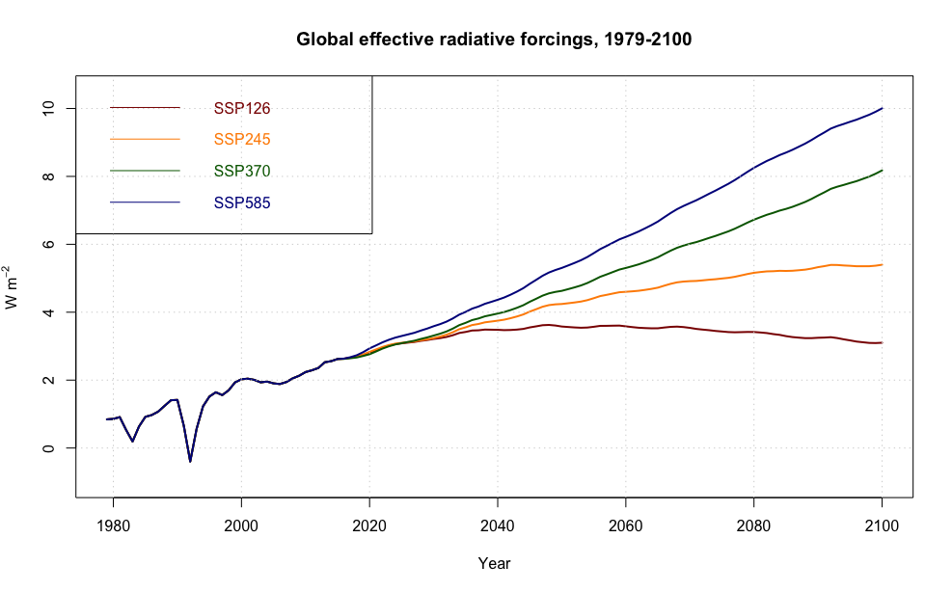
Data
Effective radiative forcings (ERF)
Historical (1979-2014) and future estimates (2015- 2100) of the “effective radiative forcing” (ERF).
ERF represents a combined effect of GHG concentrations and other forcing agents such as volcanic and solar activities.
It is a valuable indicator of the eventual temperature response.
Figure 5: Annual time series of effective radiative forcings corresponding to SSP126, SSP245, SSP370, and SSP585.
Notes:
The atmospheric forcings used to drive the CMIP6 model simulations under each emission scenarios SSP126, SSP245, SSP370, and SSP585 are the historical (1979-2014) and future (2015- 2100) estimates of greenhouse gas concentrations and other forcing factors such as volcanic and solar activities. The “effective radiative forcing” (ERF) represents a combined effect of those forcing agents, and is acknowledged as a valuable indicator of the eventual temperature response

Slide 8
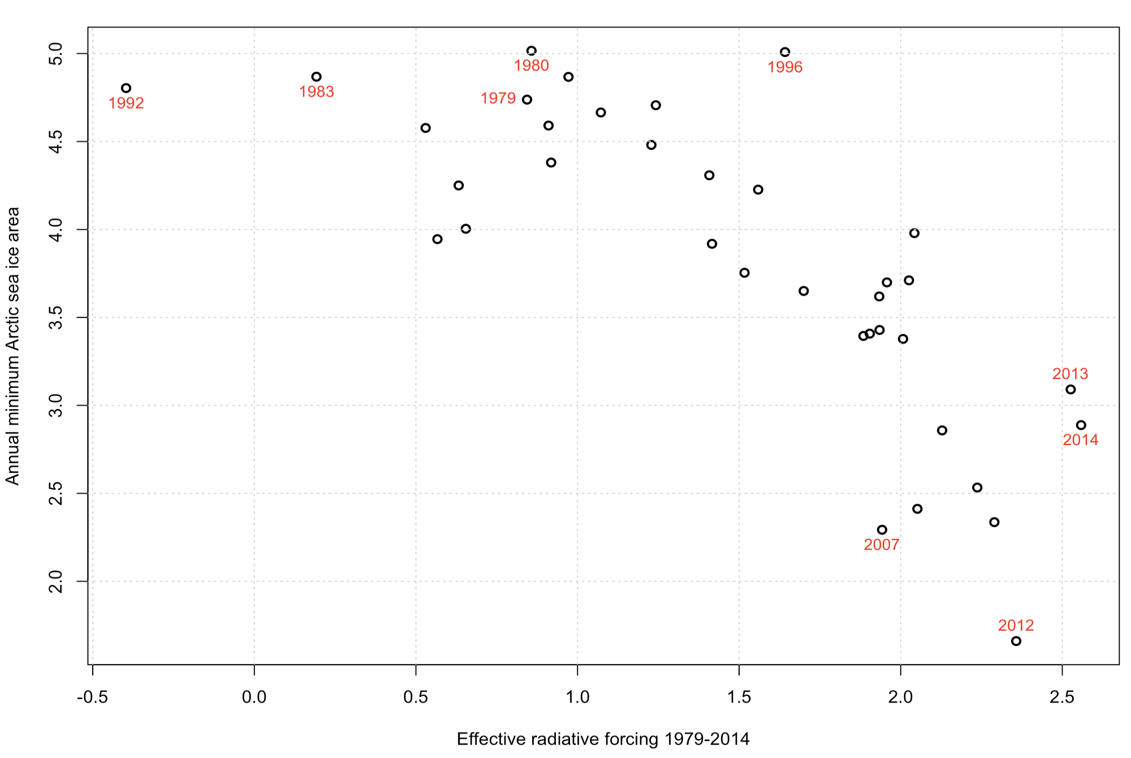
Data
Effective radiative forcings (ERF)
There is a negative relationship between the annual minimum sea ice area and the estimated effective radiative forcings between 1979 and 2014.
Figure 6: Annual minimum Arctic sea ice area against historical forcings 1979-2014.
Notes:
The atmospheric forcings used to drive the CMIP6 model simulations under each emission scenarios SSP126, SSP245, SSP370, and SSP585 are the historical (1979-2014) and future (2015- 2100) estimates of greenhouse gas concentrations and other forcing factors such as volcanic and solar activities. The “effective radiative forcing” (ERF) represents a combined effect of those forcing agents, and is acknowledged as a valuable indicator of the eventual temperature response
There is a negative relationship between the annual minimum sea ice area and the estimated effective radiative forcings between 1979 and 2014.

Slide 9
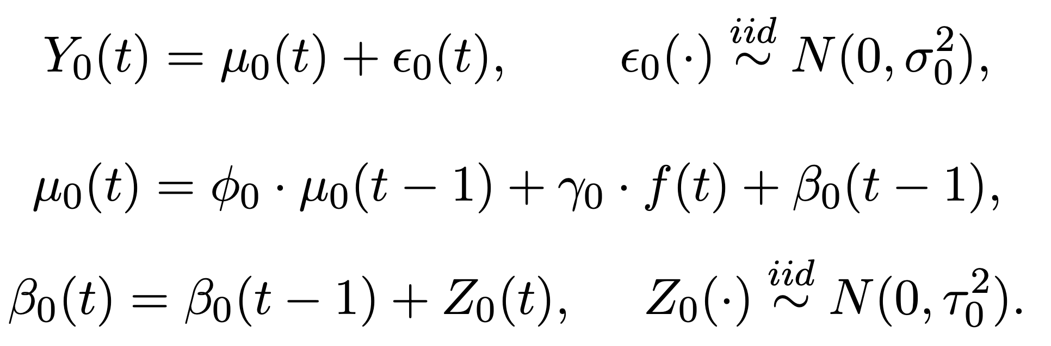
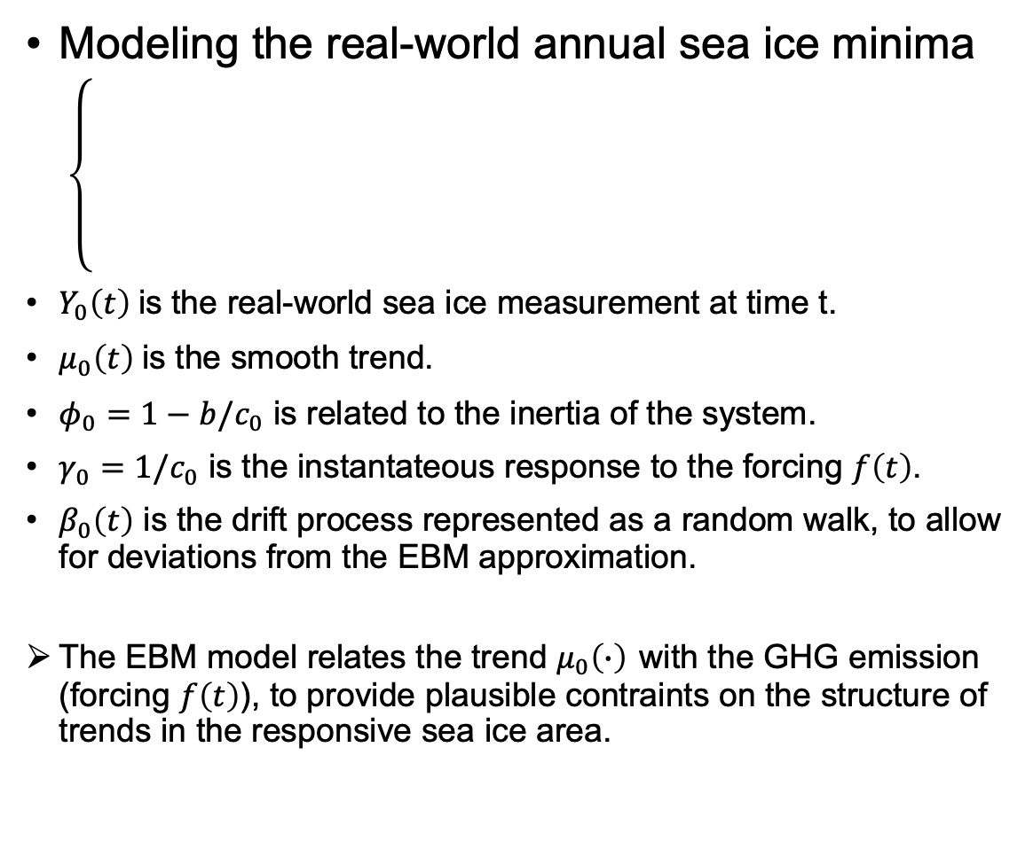
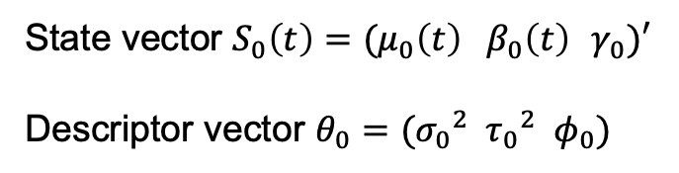
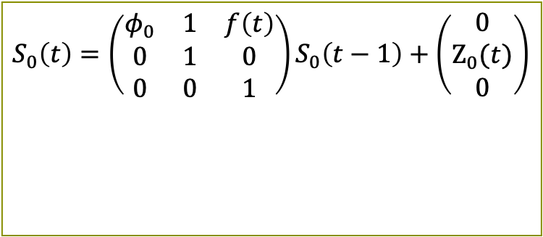
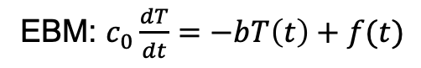
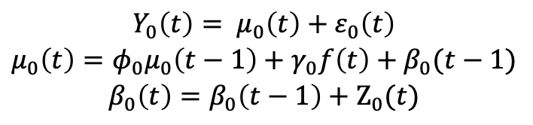
Methodology
Parameters representing physical characteristics of the system
Modeling the real-world annual sea ice minima
$Y_{0}\left(t\right)$ is the real-world sea ice measurement at time t.
$μ_{0}\left(t\right)$ is the smooth trend.
$φ_{0}=1−b/c_{0}$ is related to the inertia of the system.
$γ_{0}=1/c_{0}$ is the instantateous response to the forcing $f\left(t\right)$.
$β_{0}\left(t\right)$ is the drift process represented as a random walk, to allow for deviations from the EBM approximation.
The EBM model relates the trend $μ_{0}\left(∙\right)$ with the GHG emission (forcing $f\left(t\right)$), to provide plausible contraints on the structure of trends in the responsive sea ice area.
EBM: $c_{0}\frac{dT}{dt}=−bT\left(t\right)+f(t)$
forcing
Perturbation of equilibrium global temperature
$$\begin{aligned}Y_{0}\left(t\right)= μ_{0}\left(t\right)+ε_{0}\left(t\right)\#\#\# \\ μ_{0}\left(t\right)=φ_{0}μ_{0}\left(t−1\right)+γ_{0}f\left(t\right)+β_{0}(t−1) \\ β_{0}\left(t\right)=β_{0}\left(t−1\right)+Ζ_{0}(t)\end{aligned}$$
State-space formulation
$$S_{0}\left(t\right)=\left(\begin{matrix}φ_{0} & 1 & f\left(t\right) \\ 0 & 1 & 0 \\ 0 & 0 & 1\end{matrix}\right)S_{0}\left(t−1\right)+\left(\begin{aligned}0 \\ Ζ_{0}(t) \\ 0\end{aligned}\right)$$
State vector $S_{0}\left(t\right)=(μ_{0}\left(t\right)$ ${ β}_{0}\left(t\right)$ $γ_{0})′$
Descriptor vector $θ_{0}=({σ_{0}}^{2}{{ τ}_{0}}^{2}{ φ}_{0})$
Notes:
Mu0 is the smooth trend, epsilon0 is irregular variations
Beta is drift: the deviation from

Slide 10
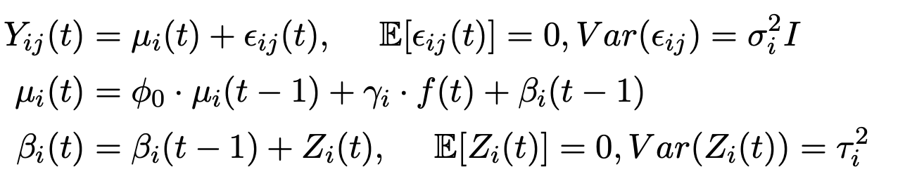
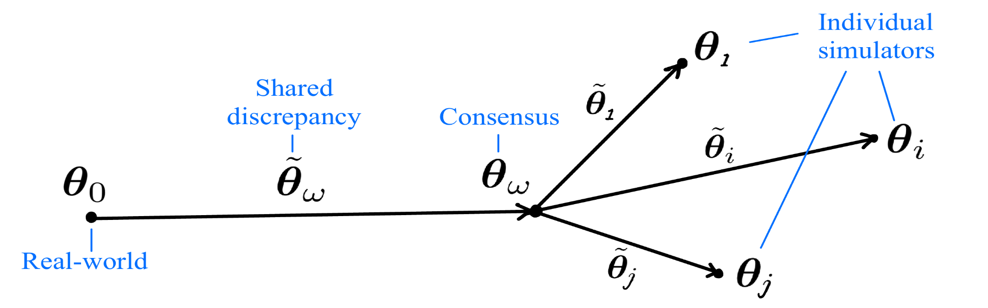
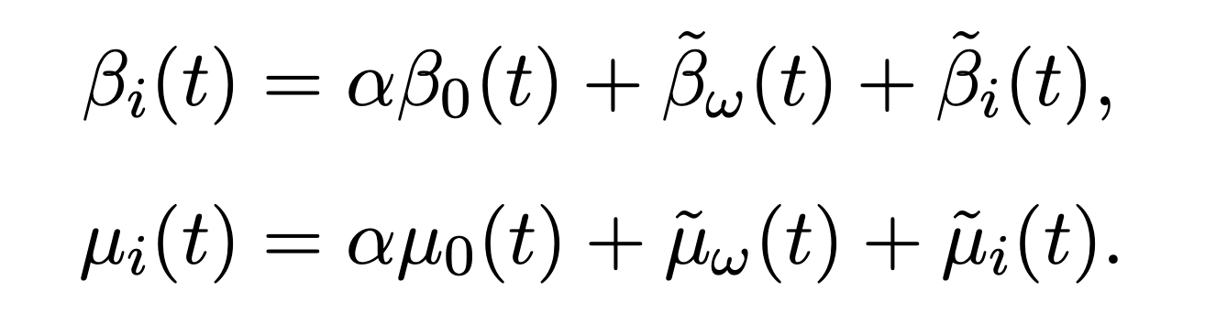
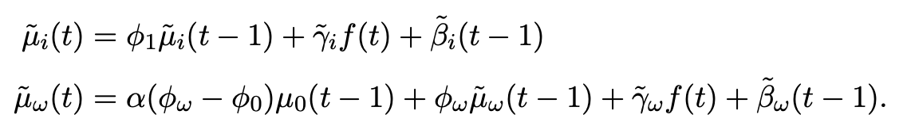
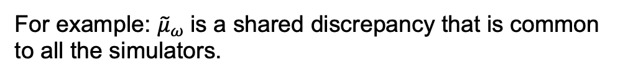

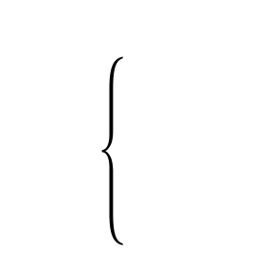
Methodology
The climate models share common ancestor models, and share similar limited knowledge to the earth system
Simulators are potentially not independent within the ensemble members.
Imperil uncertainty measurement.
Shared discrepancy framework is introduced to remove dependencies, which enables defensible assessment of uncertainty.
Generalise the model for ensemble of simulators
The $j^{th}$ th run from the $i^{th}$ simulator:
Shared discrepency framework:
For example: ${\tilde{μ}}_{ω}$is a shared discrepancy that is common to all the simulators.
Similar partitioning is applied to other quantities.
Notes:
Independence is needed for using conditional probabilities to build posterior distributions of the parameters.

Slide 11
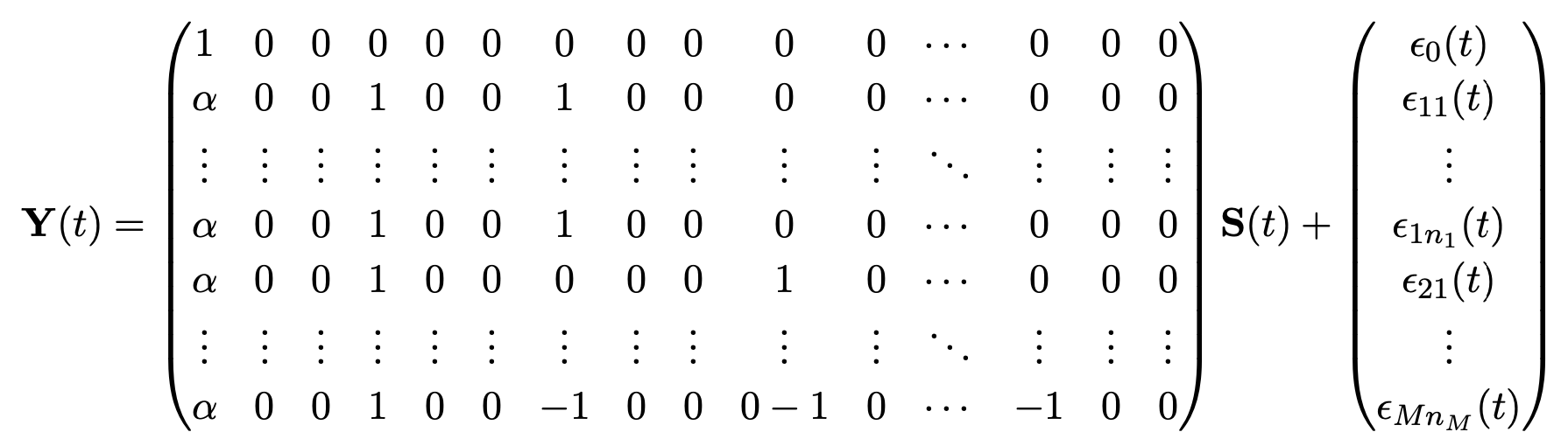
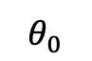
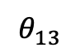
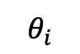
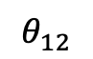
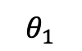
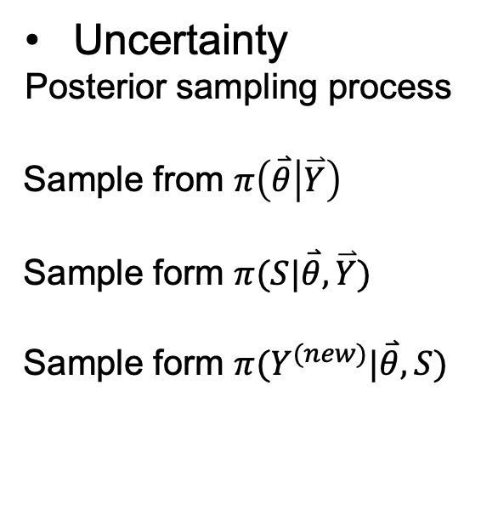
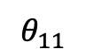
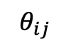
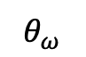
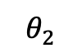
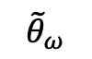
Methodology
Uncertainty
Posterior sampling process
Sample from $π\left(\overset{⃑}{θ} | \overset{⃑}{Y}\right)$
Sample form $π(S|\overset{⃑}{θ},\overset{⃑}{Y})$
Sample form $π(Y^{(new)}|\overset{⃑}{θ},S)$
Generalise the model for ensemble of simulators
Full state-space representation:
$$θ_{13}$$
$$θ_{11}$$
$$θ_{1}$$
$$θ_{12}$$
$$θ_{0}$$
$${\tilde{θ}}_{ω}$$
$$θ_{ω}$$
$$θ_{ij}$$
$$θ_{i}$$
$$θ_{2}$$
$$S\left(t\right)=\left(μ_{0}\left(t\right){ β}_{0}\left(t\right){ γ}_{0}{ \tilde{μ}}_{ω}\left(t\right){ \tilde{β}}_{ω}\left(t\right) {\tilde{γ}}_{ω}{ \tilde{μ}}_{1}\left(t\right){ \tilde{β}}_{1}\left(t\right) {\tilde{γ}}_{1} …{ \tilde{μ}}_{M−1}\left(t\right){ \tilde{β}}_{M−1}\left(t\right) {\tilde{γ}}_{M−1}\right)$$
Eight descriptors to be estimated:$θ=( {σ_{0}}^{2}{{ τ}_{0}}^{2}{ φ}_{0}$ $α{{ \tilde{τ}}_{ω}}^{2}$ $φ_{ω}$ ${σ_{1}}^{2}{{ τ}_{1}}^{2})$
Maximum likelihood estimation (MLE) is applied to estimate the descriptors, with the likelihood function constructed by applying the Kalman filter on the state-space form of the model.
The state vectors are estimated using Kalman smoother.
Notes:
Suppose we already have the observed data y1, y2, y3,. . . , yT , and we intend to use these observations to capture the properties of this time series. We applied the state-space model here, thus we consider using these observations to learn something(ie. estimate it) about the underlying state vector –t. We can use the Kalman filter and smoother to achieve that goal.

Slide 12
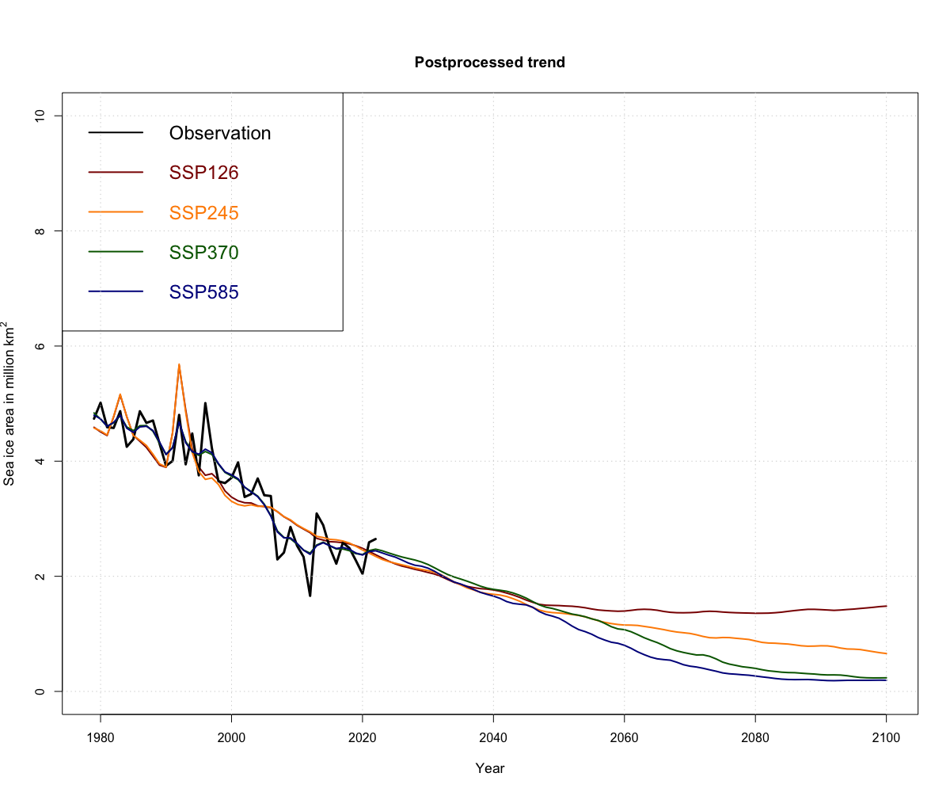
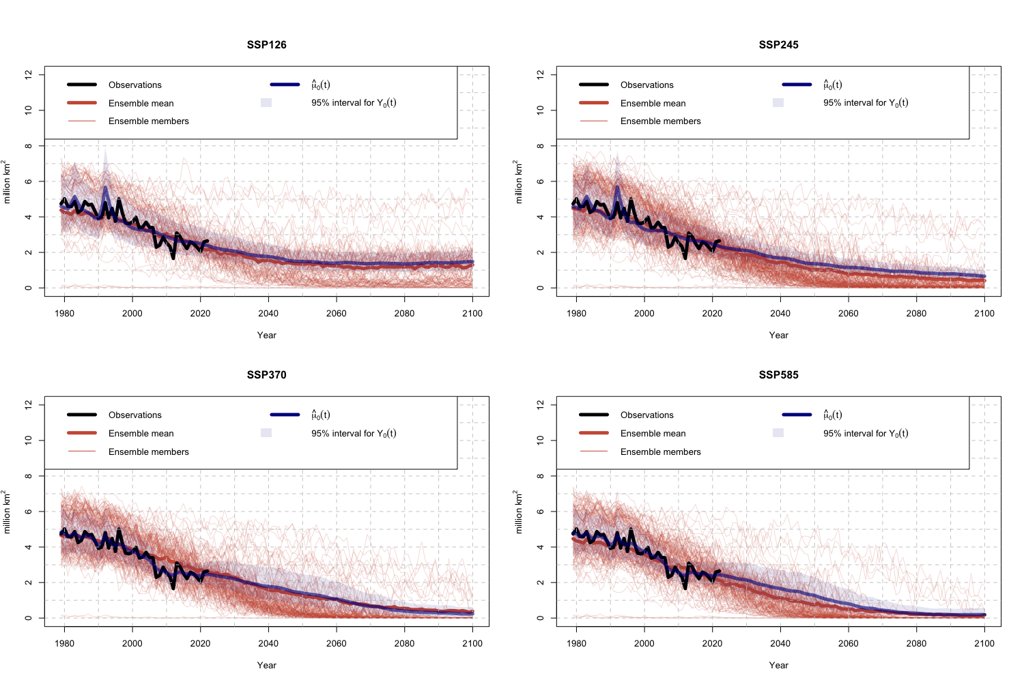
Results
Parameter estimation and trend projection
Figure 7: Postprocessed ensembles of annual minimum Arctic sea ice extent, under experiments SSP 126, 245, 370, and 585.
Figure 8: Kalman smoothed trend projections from postprocessed ensembles of annual minimum Arctic sea ice extent under SSPs 126, 245, 370, and 585.
Notes:
Having estimated the state vectors and descriptors, we are able to generate trend projections from the posterior distributions.
Under all emission scenarios, the annual minimum sea ice extent is projected to decline, although in SSP126 there is a slight upward tendency from around 2050. We can see that the higher the SSP scenario, the faster the projected decline, and the year when annual minimum sea ice area falls below some threshold is earlier in higher emission scenarios.

Slide 13
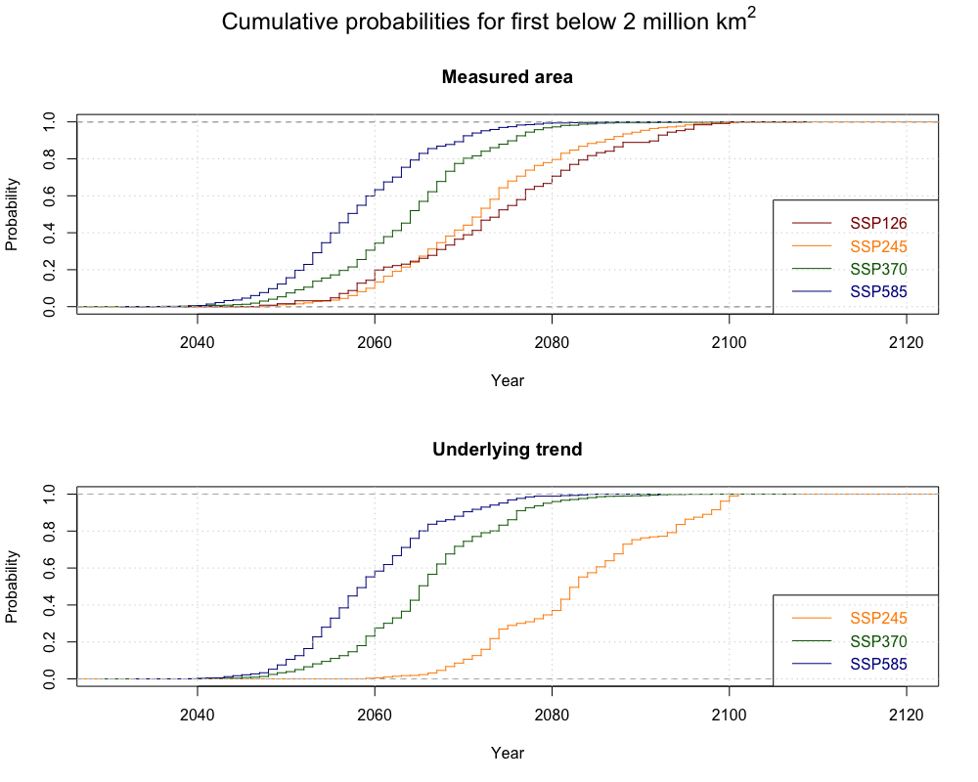
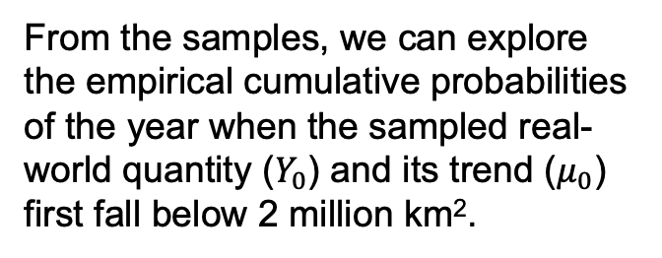
Results
Uncertainty
We obtain 1000 posterior samples.
From the samples, we can explore the empirical cumulative probabilities of the year when the sampled real-world quantity ($Y_{0}$) and its trend ($μ_{0}$) first fall below 2 million km².
Figure 9: Cumulative probabilities for the year when real-world measured annual minimum sea ice extent (top plot) and its underlying trend (bottom plot) fall below 2 million km2, under SSP experiments 126, 245, 370, and 585.
Notes:
in SSP370 and SSP585 development pathways, the measured Arctic sea ice would fall below 2 million km2 by the year 2080 almost surely, while this is less likely to happen with a posterior probability of 0.8 and 0.7 if in SSP245 and SSP126 scenarios, respectively.
the real-world measured sea ice is likely to approach the threshold earlier than does the underlying trend, because there are more variations in Y0 than in μ0.

Slide 14
Conclusion
Summary: framework
Results show…
DATA
CMIP6 simulators
Satellite measurements
GHG forcings
Scenario | Annual minimal Artic sea ice extent will…
SSP370 SSP585 | Decline rapidly and fall below 2 million km² by the year 2080 or earlier, with probability almost 1.
SSP245 | Intermediate evolution, and will fall below 2 million km² by the end of the century almost surely.
SSP126 | Possibly remain above 2 million km² by the end of this century.
Multi-model structure: shared discrepancies between simulator outputs and reality.
EBM-inspired state-space model: relate the trend with forcings of GHG emissions.
generalise
assist
enable
&
Parameter estimation and trend projections
Future work
Problems introduced by log-transformation
Reduce pole hole area
. Possible non-linear relationship between the effective radiative forcings and the annual minimum sea ice area
Uncertainty quantification
Aim
achieve
achieve
Posterior sampling
Kalman fliter and smoother
Notes:
The shared discrepancy framework assists the uncertainty quantification by reducing the dependencies of simulator errors between simulators.
The results suggested that in pathways with high GHG emissions (SSP370 and SSP585), the minimum sea ice extent is projected to decline rapidly and fall below 2 million km2 by the year 2080 or earlier, with probability almost 1. Under a sustainable development pathway (SSP126) however, the minimal sea ice is possible to remain above this threshold by the end of this century.

Slide 15


Thank you for your attention.
I am happy to answer any questions you have!
UCL Faculty of Mathematical & Physical Sciences
Department of Mathematics
This Photo by Unknown Author is licensed under CC BY-SA-NC
Notes:
So that’s all of my presentation, I’d be happy to answer any questions you have.

